Slide 1
Facial Emotion Recognition on FER2013
Using VGGNet
Team
Jiaming Yu, jiamingy@bu.edu
Tengzi Zhao, tengzi@bu.edu
REFERENCES:
[1] Zhang J., Bargal S. A., Lin Z., Brandt J., Shen X., & Sclaroff S. (2018). Top-down neural attention by excitation backprop – International Journal of Computer Vision, 126(10), 1084-1102.
[2] Bargal S. A.*, Zunino A.*, Kim D., Zhang J., Murino V. and Sclaroff S. (2018). Excitation Backprop for RNNs – Proc. IEEE Conf. on Computer Vision and Pattern Recognition (CVPR).
[3] Zunino A.*, Bargal S. A.*, Morerio P., Zhang J., Sclaroff S., & Murino V. (2018). Excitation Dropout: Encouraging Plasticity in Deep Neural Networks – arXiv preprint arXiv:1805.09092.

Slide 2
Motivation
Facial emotion recognition(FER) refers to identifying expressions that convey basic emotions
FER has broad research prospects in human-computer interaction and emotional computing
Applications: intelligent medical care, market research, online game testing
However, accurate and robust FER by computer models remains challenging
Therefore, it is important to explore the CNN network to help extract features for FER
Notes:
Let’s talk about our motivation of this project. This project aims to explore facial emotion recognition. Facial emotion recognition refers to identifying expressions that convey basic emotions, which is quite important for computer to understand human beings. FER has broad research prospects in human-computer interaction and emotional computing, including human-computer interaction, emotion analysis, intelligent security, entertainment, online education, intelligent medical care, etc. For example, it can be used to conduct market research for companies and obtain users' feedback to test video games. However, accurate and robust FER by computer models remains challenging due to the heterogeneity of human faces and variations in images such as different facial pose and lighting. Among all techniques for FER, deep learning models, especially Convolutional Neural Networks (CNNs) have shown great potential due to their powerful automatic feature extraction and computational efficiency.

Slide 3
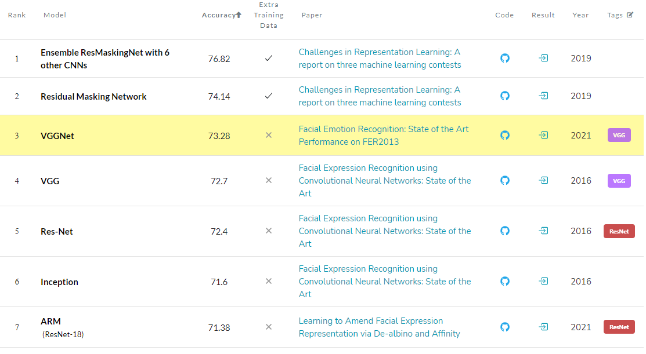
Goal
Reproduce the paper to achieve highest state-of-art single-network accuracy of 73.28% on FER2013 without using extra training data
Experiment on optimizer, scheduler, fine tuning as the paper discusses and dropout rate which is not discussed by the paper
Evaluate the result with confusion matrix and saliency map
Notes:
Then we set our goals. We researched on the rankings and decide to reproduce the highest single-network using only the FER2013 to train.
We also aim to experiment on optimizer, scheduler, fine tuning and dropout rate which are discussed or not discussed by the paper
Besides, another goal is to evaluate the result with confusion matrix and saliency map

Slide 4
Main Reference Work
Khaireddin, Y., & Chen, Z. (2021): Facial Emotion Recognition: State of the Art Performance on FER2013. arXiv preprint arXiv:2105.03588.
https://github.com/usef-kh/fer
FER2013 Dataset:
https://www.kaggle.com/c/challenges-in-representation-learning-facial-expression-recognition-challenge/data
Sebastian Ruder: An overview of gradient descent optimization algorithms. 19 JAN 2016:
https://ruder.io/optimizing-gradient-descent/index.html
Notes:
So here’s the main reference work we used
1.link for the paper we used
2.link for dataset
3. the link we used to learn more about different optimizer

Slide 5
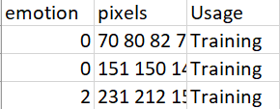
Method
Dataset:
FER2013:
Classify facial expressions from 35,685 examples of 48x48 pixel grayscale images of faces.
emotion_mapping = {0: 'Angry', 1: 'Disgust', 2: 'Fear', 3: 'Happy', 4: 'Sad', 5: 'Surprise', 6: 'Neutral'}
Notes:
First let’s take a look at the dataset we used.
Here is how fer2013.csv looks like
Each row here represents one graph. Images are categorized based on the emotion shown in the facial expressions. The column emotion is the class the image belongs to. We can see there are 7 classes and here is the emotion mapping.
The column pixels is the grayscale pixel matrix which represent the image.
And FER2013 can be divided to training set, privacy testing set(validation set) and public testing set(testing set). And the usage column represent how to split the images into different sets.

Slide 6
Method
Overall method graph
Image
VGGnet
Emotion
Loss
Data Augmentation
Optimizer: SGD Nesterov
Scheduler: RLRP
Dropout: 0.2
Classification Loss:
Cross-entropy
Backpropagation
Notes:
And here is the overall methods graph which we will introduce more details later. We use image
as inputs and augment the data and pass it through VGGnet for training. And the model will produce emotion classes for calculating classification loss. And then it do the backpropagation to update the parameters.

Slide 7
Method
VGGnet: Convolutional Neural Network (CNN)
VGG characteristics:
Conv kernels: 3x3
Maxpool kernels: 2x2, stride: 2
Batch normalization: Speed up the learning process
Notes:
So let’s take a look at more detailed methods.
VGGNet is a classical convolutional neural network architecture used in large-scale image processing and pattern recognition
The important point to note here is that all the convolutional kernels are of size 3x3 and maxpooling layers are of size 2x2 with a stride of two.
And our VGG model use batch normalization to speed up the learning process, reduce the internal covariance shift, and prevent gradient vanishing or explosion

Slide 8
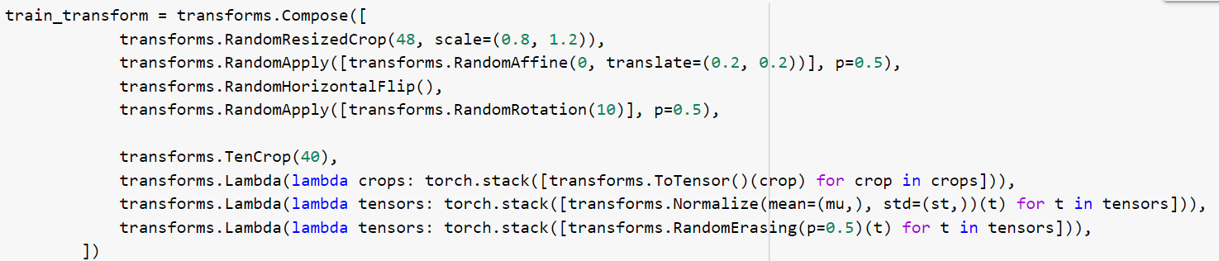

Method
Prevent overfitting
Data augmentation
Dropout
Notes:
To prevent overfitting, the paper use data augmentation and dropout layer. We can see the model uses resize, flip, transform, rotation, erasing and so on for data augmentation.
It also use dropout at the fully connected layer with dropout rate=0.2

Slide 9
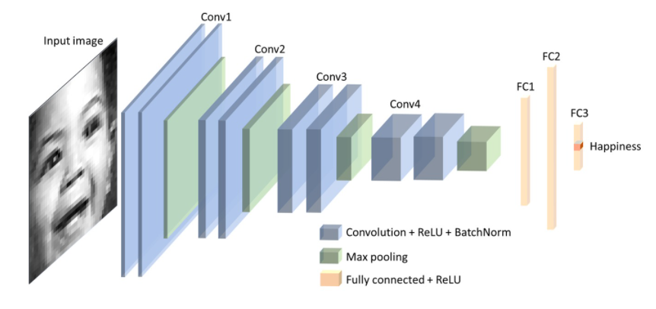
Architecture
Notes:
And now let’s take a look at the architecture. As a reminder the conv kernels are 3 by 3 and maxpooling size 2x2, stride=2
The network consists of 4 convolutional stages and 3 fully connected layers. Each of the convolutional stages contains two convolutional blocks and a max-pooling layer. The convolution block consists of a convolutional layer, a ReLU activation, and a batch normalization layer.
The first two fully connected layers are followed by a ReLU activation. And the third fully connected layer is for classification. The convolutional stages are responsible for feature extraction, dimension reduction, and non-linearity. The fully connected layers are trained to classify the inputs as described by extracted features.

Slide 10
Training Details
Optimizer | SGD with Nesterov Momentum
LR Scheduler | Reduce Learning Rate on Plateau, init LR=0.01
Overfitting | Dropout & Data Augmentation
Epoch numbers | 300 epochs training + 50 epochs fine tuning
Loss function | Cross-entropy loss
Notes:
Plateau[plæˈtoʊ], which is RLRP
and the loss function we use is cross-entropy since this is a classification problem

Slide 11
Experimental Setup
Optimizer
Adadelta, Adagrad, Adam,Adam with AMSgrad, ASGD, SGD, SGD with Nesterov
Scheduler:
OneCycleLR, StepLR, Cosine, CosineWR, RLRP, constant
Architecture:
Efficientnetb3, ResNet50, VGG16, VGG Varient
Fine tuning:
Cosine, CosineWR + training with validation data
Notes:
Here is the experimental setup. We made some changes to get the best model
We changed 4 main part of the model, which are optimizer, scheduler, architecture and fine tuning.
For optimizer, we use 7 different methods as listed above.
For scheduler we use 6 different methods.
And we also test 3 different architecture.
After training 300 epoches, we examed another 50 epoches using two different scheduler: Cosine Annealing (Cosine), Cosine Annealing with Warm Restarts (CosineWR) and furthermore used validation data to train

Slide 12
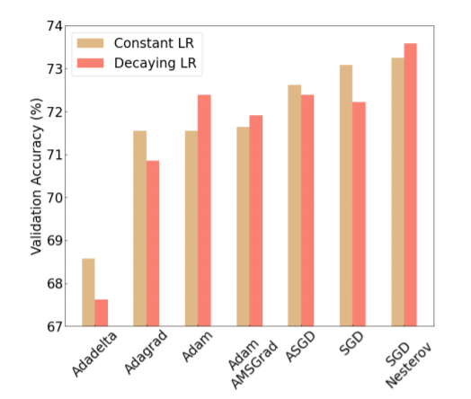
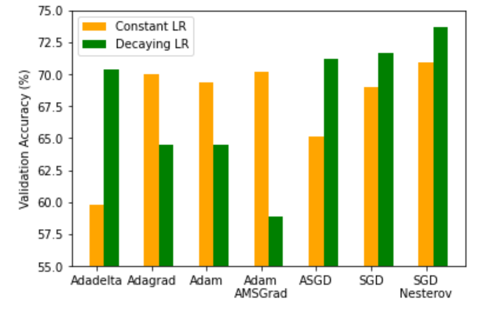
Experimental Results - Optimizer
Left: Result the paper got after training 300 epochs.
Right: Result we got after training 100 epochs due to time limit.
Notes:
We can see the most accurate optimizer from both side is SGD with Nesterov Momentum. So what is SGD with Nesterov momentum?

Slide 13
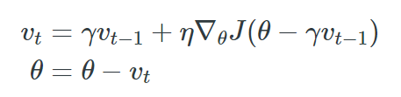
SGD with Nesterov Momentum
SGD:
Simple technique that updates the parameters of a model based on the gradient of a single data point.
Momentum:
Method that helps accelerate SGD in the relevant direction and dampens oscillations
Nesterov Momentum:
Compute approximation of the next position of the parameters to effectively look ahead
Notes:
The most commonly used optimizer is Stochastic gradient descent (SGD). It is a simple technique that updates the parameters of a model based on the gradient of a single data point.
And Momentum is a method that helps accelerate SGD in the relevant direction and dampens oscillations. And it is usually been set to 0.9, which is also the number been used in the model.
Nesterov momentum: gives us an approximation of the next position of the parameters (the gradient is missing for the full update), a rough idea where our parameters are going to be. We can now effectively look ahead by calculating the gradient not to our current parameters but to the approximate future position of our parameters

Slide 14
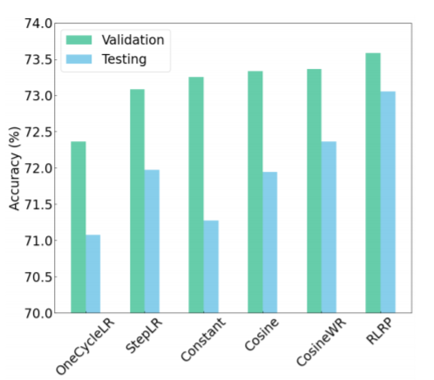
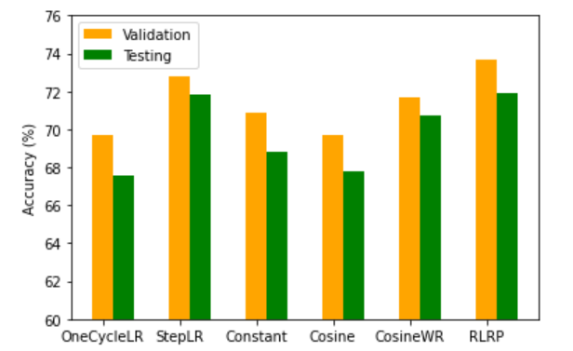
Experimental Results - Scheduler
Left: Result the paper got after training 300 epochs.
Right: Result we got after training 100 epochs due to time limit.
Notes:
We can see the the scheduler RLRP leads to the highest accuracy in both side. So let’s take a look at the RLRP scheduler

Slide 15
Reduce Learning Rate on Plateau (RLRP)
Reduce learning rate when a metric has stopped improving
Parameters:
mode: ‘max’
factor: new_lr=factor (0.75) * old_lr
patience: 5
verbose: True/1
Notes:
What RLRP does is it reduces Learning rate when a metric has stopped improving. Since it does so, we can assume that the longer we train, the smaller our step size should be
And there are some parameters that we used
1.First is mode. In 'max' mode it will be reduced when the quantity monitored has stopped increasing
2.Second, the factor means the learning rate will be reduced by 0.75
3. Third, the patience equal to 5 means the learning rate will be reduced after 5 epochs with no improvement
4. Finally, verbose means printing the update message after each time the learning rate reduced

Slide 16
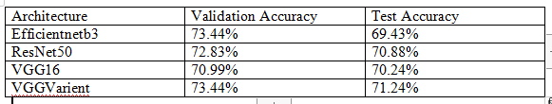
Experimental Results - Architecture
We also explore the influence of different architecture on the validation accuracy and test accuracy
The following form shows the result on 100 epochs
VGGNet proposed by the paper referenced is good
Notes:
Then I will talk about our experiment result on architecture, we also trained some baselines for comparison like pre trained efficientnetb3, resnet50, vgg16 and vggnet for 100 epochs

Slide 17
Experimental Results - Fine tuning
Fine tuning: After training 300 epoches, we trained another 50 epochs using two different scheduler: Cosine Annealing (Cosine), Cosine Annealing with Warm Restarts (CosineWR) with initial learning rate 0.0001
However, the accuracy is not good since I guess the result is already kind of overfitting for dropout probability 0.2
Therefore, we also explore the effect of fine tuning when we set the dropout to be 0.3 and 0.4
Notes:
Both of these schedulers slowly oscillate the learning rate back and forth thus not allowing for major weight changes.

Slide 18
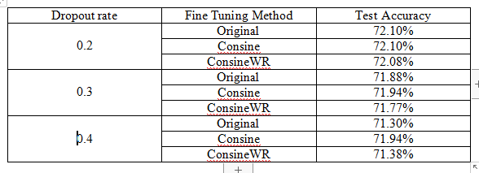
Experimental Results - Fine tuning
After increasing dropout rate to prevent overfitting, fine tuning has a positive effect compared to original 300 epochs
However, we still did not derive the result better than 72.4% we derived at 160 epochs with dropout 0.2

Slide 19
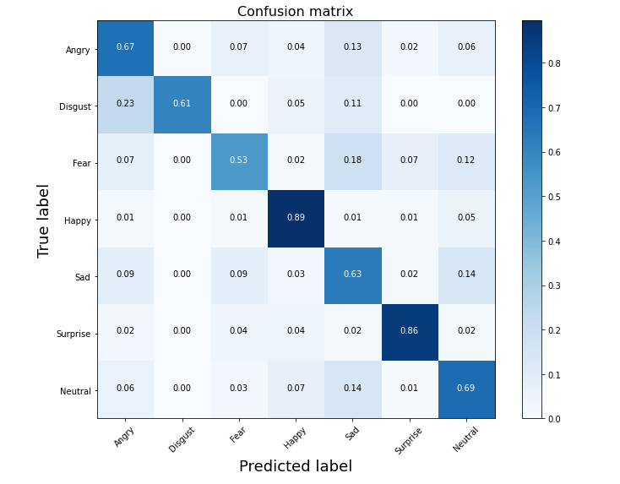
Demos
Using the checkpoint which has the best test accuracy after training 160 epochs with dropout 0.2
Confusion matrix
Class imbalance - need to be further considered
Notes:
There is a class imbalance which can be improved. There are more samples happy and surprise and thus the related performance of the network on these two labels

Slide 20
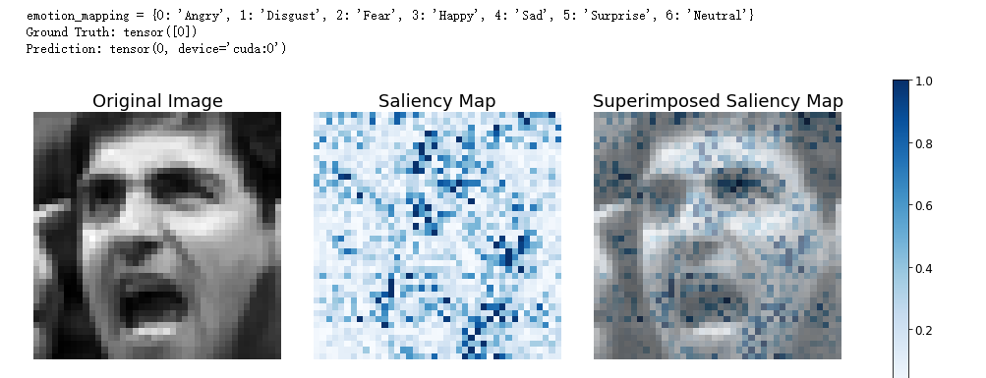
Demos
Saliency map - by propagating the loss back to the pixel values
The model is placing a large importance on facial features of the person
Notes:
We can see that the network maps the facial features instead of background, hair, hand

Slide 21
Conclusion
What we did using reference code:
Reorganize the code from py file to jupyter notebook to train 300 epochs on VGGNet to achieve 72.1%
Modify code to experiment on optimizer, scheduler, fine tuning which are discussed in paper
Modify code to experiment on architecture, drop out rate which are not discussed
Add plot_confusion_matrix function to demo part
Highest test accuracy we achieve: 72.4% while the best of the paper is 73.2%
Ethic problem: privacy problem

Slide 22
Github Link
https://github.com/JimY233/CS523_Project

Slide 23
QUESTIONS?
Thank you!

